Slide 1
Non-Linear Models Linear Models as Building Blocks
Understanding Machine Learning

Slide 2
Summary
reminder: Most ML algorithms (even unsupervised and RL) can be described by the general recipe of combining models, costs, and optimization methods.
moreover: Most powerful ML algorithms are compound, with rather simple (often linear) building blocks. → reductionism with complex interactions
look at some important examples:
neural networks
support-vector machines
decision trees, random forests, gradient-boosted decision trees
(all above: automatic interaction detection, compare to manual ones in GAMs)

Slide 3
Neural Networks

Slide 4
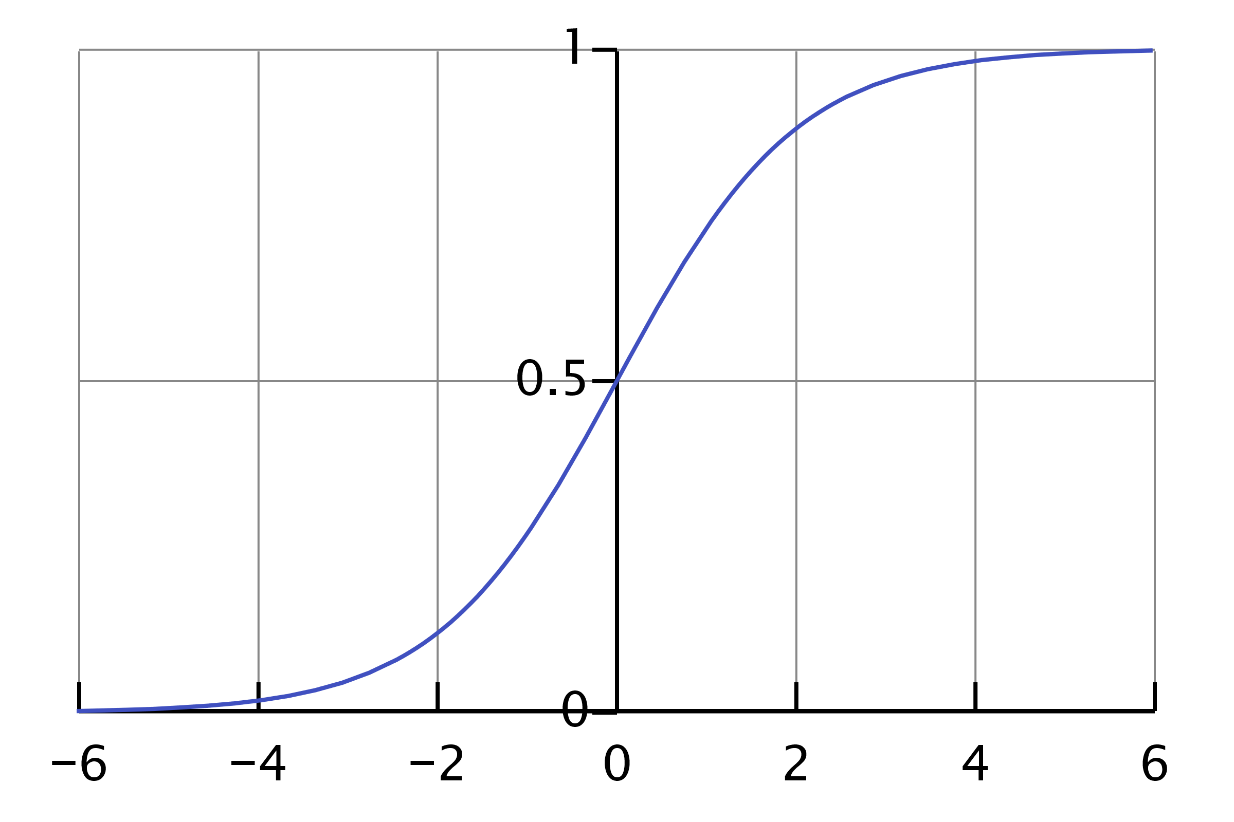
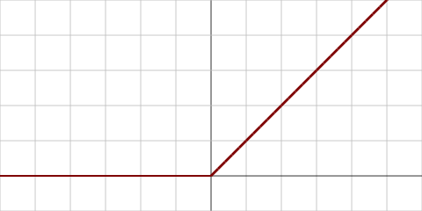
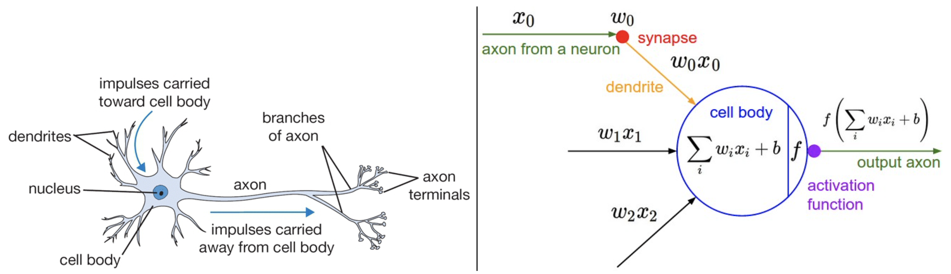
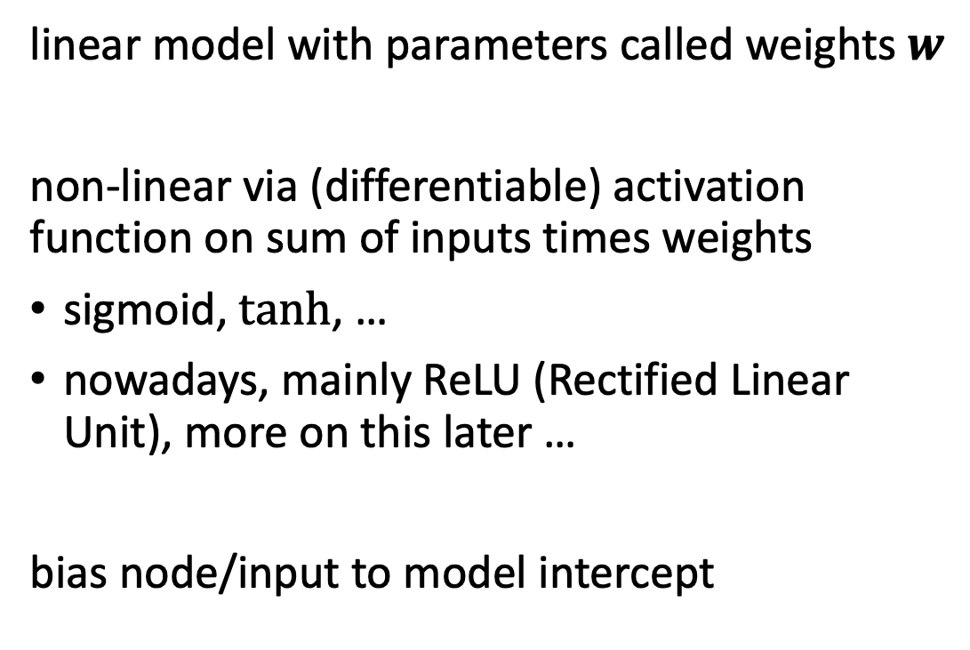
Artificial Neuron
artificial neuron (perceptron or node in neural network):
linear model with parameters called weights $w$
non-linear via (differentiable) activation function on sum of inputs times weights
sigmoid, $tanh$, …
nowadays, mainly ReLU (Rectified Linear Unit), more on this later …
bias node/input to model intercept
inspired from biological neurons:
source

Slide 5
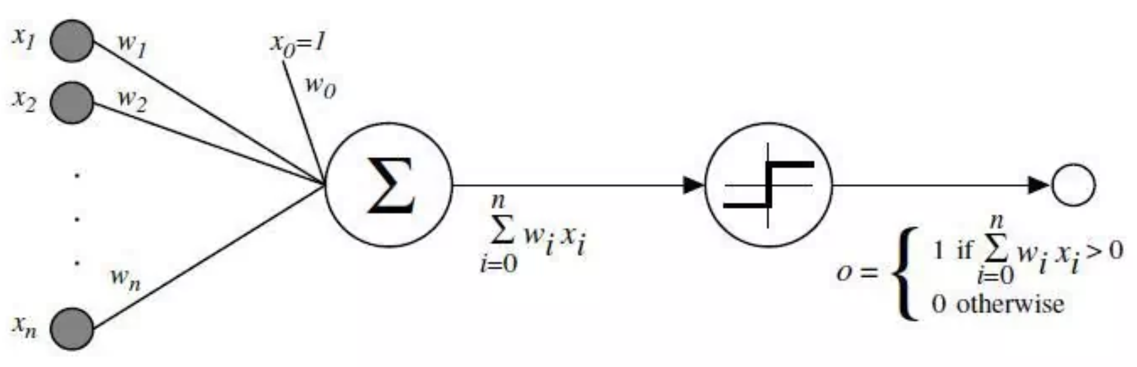
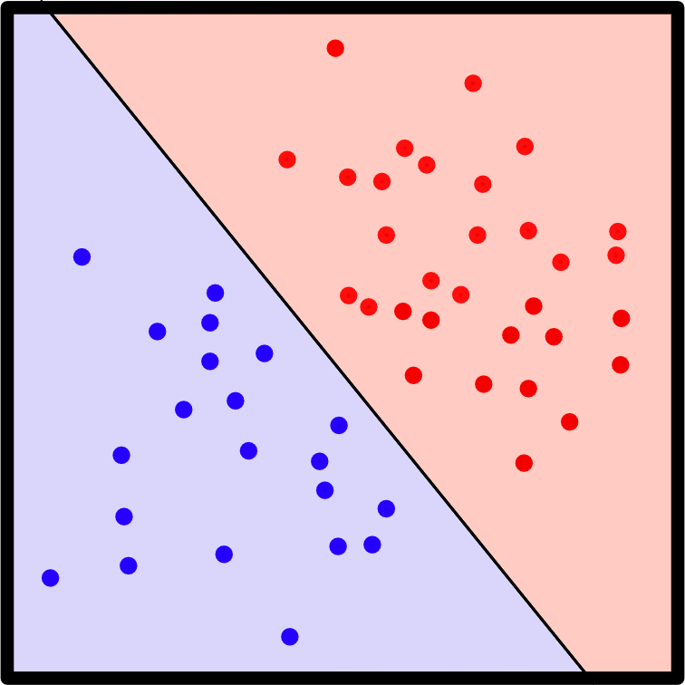
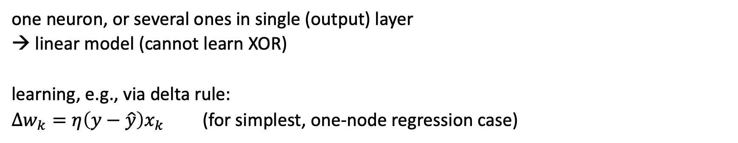
Historical: Perceptron
one neuron, or several ones in single (output) layer
→ linear model (cannot learn XOR)
learning, e.g., via delta rule:
$∆w_{k}=η\left(y−\hat{y}\right)x_{k}$ (for simplest, one-node regression case)
originally (Rosenblatt), with binary outputs (→ separating hyperplanes), threshold activation function, and perceptron learning rule:
for each training example (repeat until no more errors)
if output should have been 0 but was 1, decrease the weights that had an input of 1
if output should have been 1 but was 0, increase the weights that had an input of 1
source
from wikipedia

Slide 6

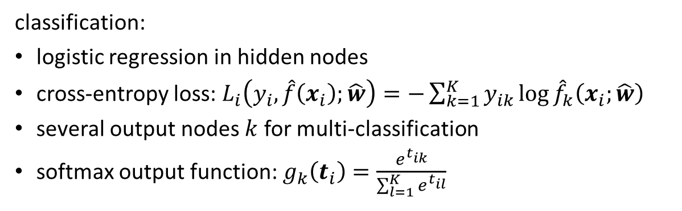
Multi-Layer Perceptron (MLP)
fully-connected feed-forward network with at least one hidden layer
can learn XOR (in fact, universal function approximator → representation learning)
toward deep learning: add hidden layers
more layers (depth) more efficient than just more nodes (width): less parameters needed for same function complexity
classification:
logistic regression in hidden nodes
cross-entropy loss: $L_{i}\left(y_{i},\hat{f}\left(x_{i}\right);\hat{w}\right)=−\sum_{k=1}^{K}{y_{ik}\log{{\hat{f}}_{k}\left(x_{i};\hat{w}\right)}}$
several output nodes $k$ for multi-classification
softmax output function: $g_{k}\left(t_{i}\right)=\frac{e^{t_{ik}}}{\sum_{l=1}^{K}{e^{t_{il}}}}$
regression:
squared error loss
identity output function
usually just one output node

Slide 7
History: AI Winter
AI hype (e.g., around perceptron) in late 1950s and 1960s
Minsky, Papert (1969): Rosenblatt’s perceptron not able to learn XOR, no learning rule for multi-layer perceptrons (→ waiting for back-propagation)
→ (or rather contributed to) AI winter in 1970s
until rise of expert systems in 1980s
its fall end of 1980 marked a second major AI winter (until mid 1990s)
but back-propagation (especially clear formulation of Hinton, Rumelhart, Williams) sparked (some) interest in neural networks again in late 1980s

Slide 8
Back-Propagation

Slide 9

Find Gradients for (Deep) Neural Networks
back-propagation of errors through layers via chain rule of calculus (avoiding redundant calculations of intermediate terms) → generalization of single-layer delta rule
each node exchanges information only with directly connected nodes → enables efficient, parallel computation
forward pass: current weights fixed, predictions computed
backward pass: errors computed from predictions and back-propagated, weights updated accordingly, e.g., via gradient descent
source

Slide 10
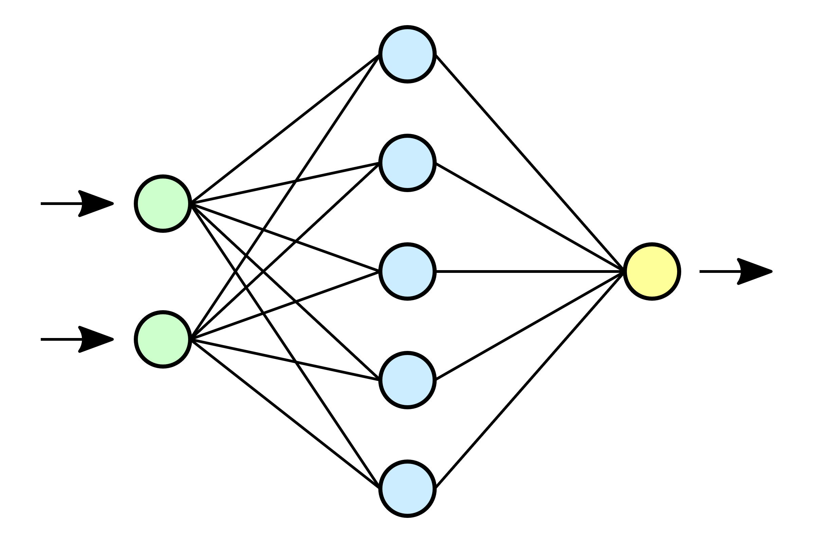


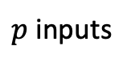


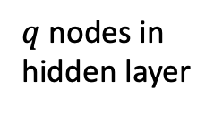




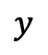
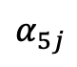



Example WOLOG
error measured here,
but not here
regression (squared error loss, identity output function $g$)
with one hidden layer ($\hat{w}$: $\hat{α}$, $\hat{β}$)
$${\hat{y}}_{i}=\hat{f}\left(x_{i};\hat{w}\right)=g\left(z_{i};\hat{β}\right)=\sum_{k=0}^{q}{{\hat{β}}_{k}z_{ik}}$$
$$z_{ik}=h\left(x_{i};{\hat{α}}_{k}\right)=h\left(\sum_{j=0}^{p}{{\hat{α}}_{kj}x_{ij}}\right)$$
cost function:
$$J\left(\hat{w}\right)=\sum_{i=1}^{n}{L_{i}\left(y_{i},\hat{f}\left(x_{i}\right);\hat{w}\right)}=\sum_{i=1}^{n}{{\left(y_{i}−\hat{f}\left(x_{i};\hat{α}\text{, }\hat{β}\right)\right)}^{2}}$$
$$z_{1}$$
$p$ inputs
$$α_{1j}$$
$$z_{2}$$
$$x_{1}$$
$$z_{3}$$
$$y$$
$$x_{2}$$
$$z_{4}$$
activation function
$$α_{5j}$$
$$β_{k}$$
$$α_{kj}$$
$$z_{5}$$
$q$ nodes in hidden layer

Slide 11
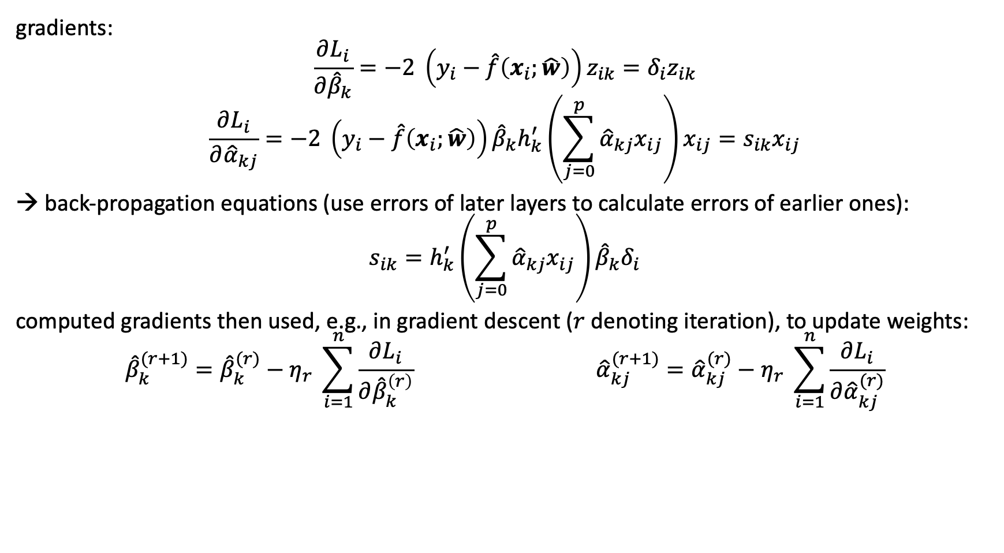
Example WOLOG
gradients:
$$\frac{∂L_{i}}{∂{\hat{β}}_{k}}=−2 \left(y_{i}−\hat{f}\left(x_{i};\hat{w}\right)\right)z_{ik}=δ_{i}z_{ik}$$
$$\frac{∂L_{i}}{∂{\hat{α}}_{kj}}=−2 \left(y_{i}−\hat{f}\left(x_{i};\hat{w}\right)\right){\hat{β}}_{k}h_{k}^{′}\left(\sum_{j=0}^{p}{{\hat{α}}_{kj}x_{ij}}\right)x_{ij}=s_{ik}x_{ij}$$
→ back-propagation equations (use errors of later layers to calculate errors of earlier ones):
$$s_{ik}=h_{k}^{′}\left(\sum_{j=0}^{p}{{\hat{α}}_{kj}x_{ij}}\right){\hat{β}}_{k}δ_{i}$$
computed gradients then used, e.g., in gradient descent ($r$ denoting iteration), to update weights:
$${\hat{β}}_{k}^{(r+1)}={\hat{β}}_{k}^{(r)}−η_{r} \sum_{i=1}^{n}{\frac{∂L_{i}}{∂{\hat{β}}_{k}^{\left(r\right)}}} {\hat{α}}_{kj}^{(r+1)}={\hat{α}}_{kj}^{(r)}−η_{r} \sum_{i=1}^{n}{\frac{∂L_{i}}{∂{\hat{α}}_{kj}^{(r)}}}$$
learning rate

Slide 12
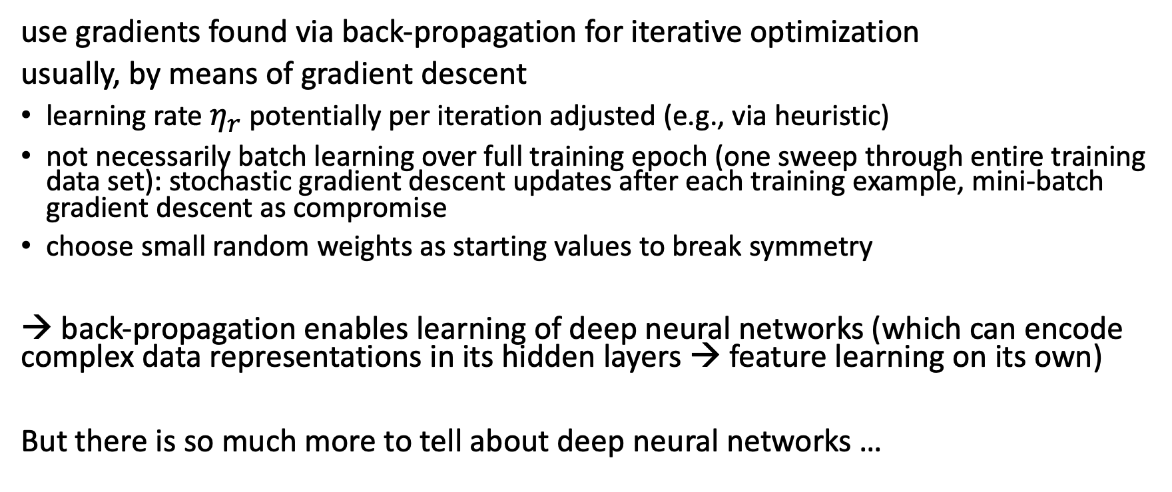
Using Gradients for Iterative Learning
use gradients found via back-propagation for iterative optimization
usually, by means of gradient descent
learning rate $η_{r}$ potentially per iteration adjusted (e.g., via heuristic)
not necessarily batch learning over full training epoch (one sweep through entire training data set): stochastic gradient descent updates after each training example, mini-batch gradient descent as compromise
choose small random weights as starting values to break symmetry
→ back-propagation enables learning of deep neural networks (which can encode complex data representations in its hidden layers → feature learning on its own)
But there is so much more to tell about deep neural networks …

Slide 13
Kernel Machines

Slide 14
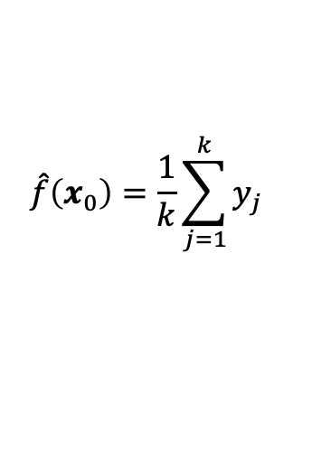
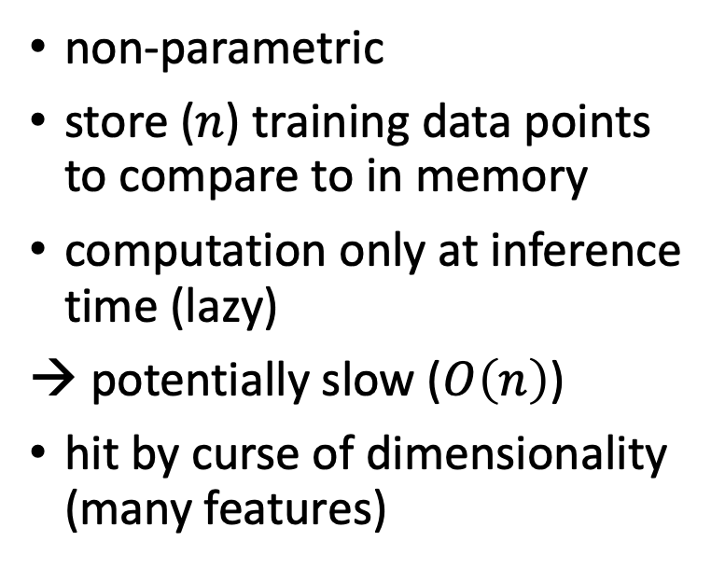
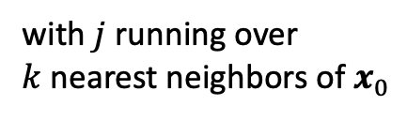
Instance-Based Learning
predict (e.g., classify) new data point by comparing with similar instances seen in training
→ need for a distance metric to choose nearest neighbors (e.g., Euclidean)
non-parametric
store ($n$) training data points to compare to in memory
computation only at inference time (lazy)
potentially slow ($O\left(n\right)$)
hit by curse of dimensionality (many features)
example:
regression with k-nearest neighbors (kNN)
$$\hat{f}\left(x_{0}\right)=\frac{1}{k}\sum_{j=1}^{k}{y_{j}}$$
with $j$ running over $k$nearest neighbors of $x_{0}$

Slide 15
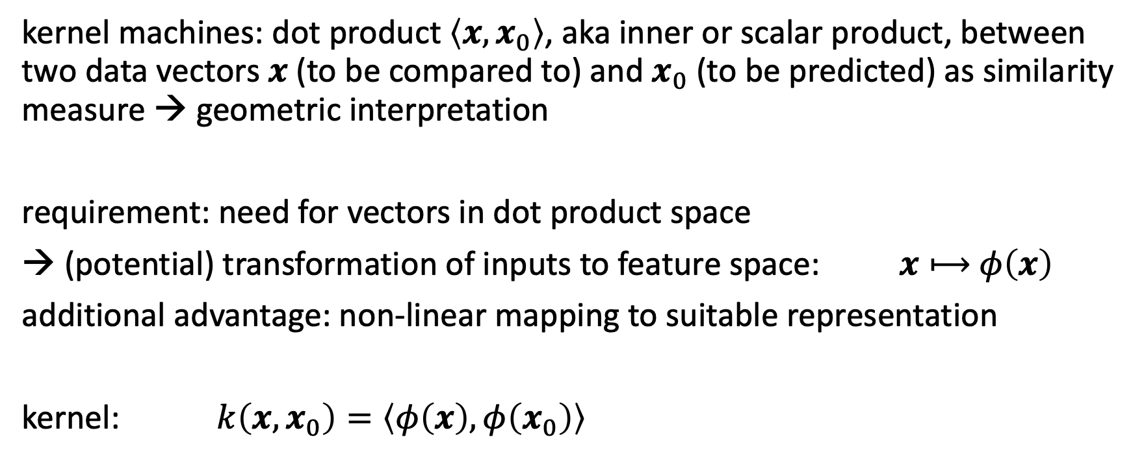
Similarity Function
kernel machines: dot product $\left\langle x,x_{0}\right\rangle$, aka inner or scalar product, between two data vectors $x$ (to be compared to) and $x_{0}$ (to be predicted) as similarity measure → geometric interpretation
requirement: need for vectors in dot product space
→ (potential) transformation of inputs to feature space: $x⟼$ $φ\left(x\right)$
additional advantage: non-linear mapping to suitable representation
kernel: $k\left(x,x_{0}\right)=\left\langle φ\left(x\right),φ\left(x_{0}\right)\right\rangle$

Slide 16
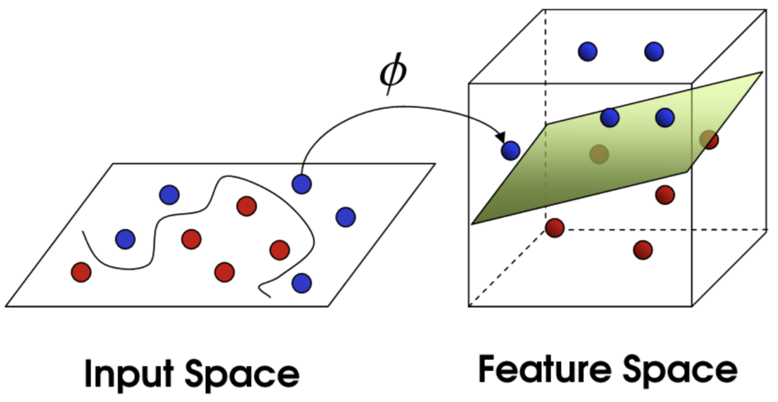
Non-Linear Transformation
example: data not linearly separable in input space
solution: transformation into higher-dimensional feature space
→ linearly separable by hyperplane in feature space
from towardsdatascience.com
options:
explict feature engineering (feature map)
definition of similarity function over pairs of data points → higher abstraction

Slide 17
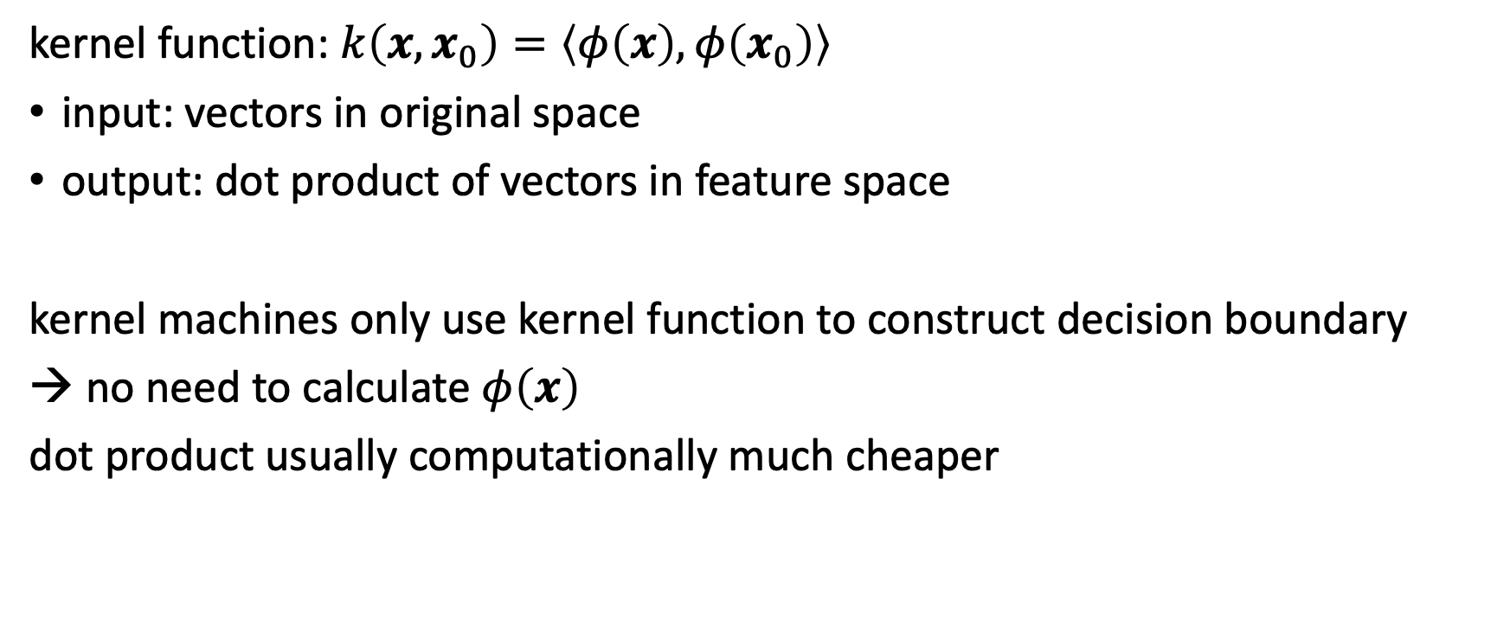
Kernel Trick
kernel function: $k\left(x,x_{0}\right)=\left\langle φ\left(x\right),φ\left(x_{0}\right)\right\rangle$
input: vectors in original space
output: dot product of vectors in feature space
kernel machines only use kernel function to construct decision boundary
→ no need to calculate $φ\left(x\right)$
dot product usually computationally much cheaper

Slide 18
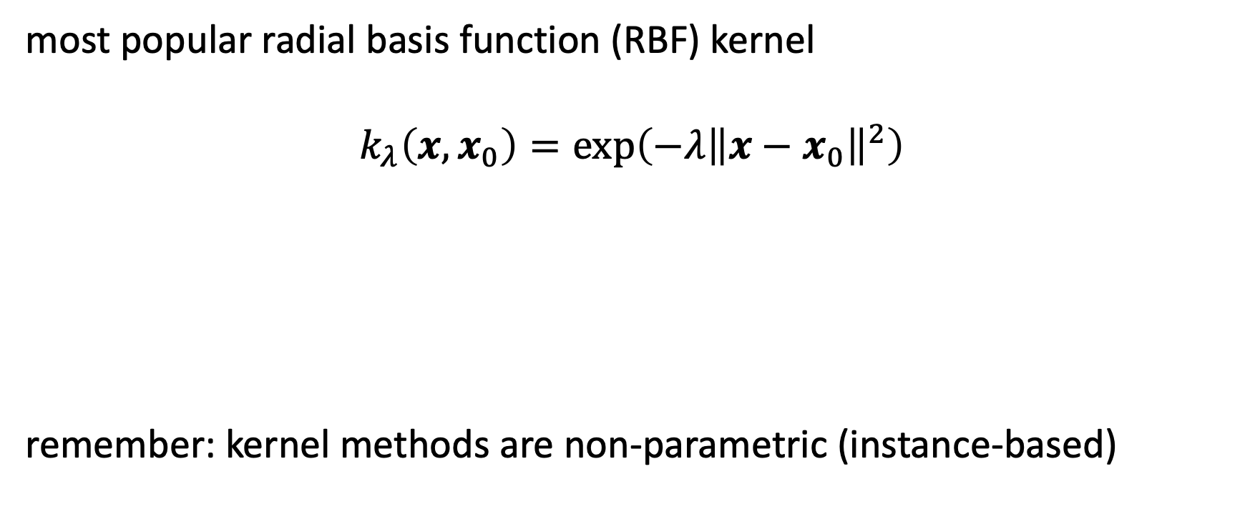
Example: Gaussian Kernel
most popular radial basis function (RBF) kernel
$$k_{λ}\left(x,x_{0}\right)=\exp\left(−λ{\left\|x−x_{0}\right\|}^{2}\right)$$
remember: kernel methods are non-parametric (instance-based)
Euclidean distance
hyperparameter

Slide 19
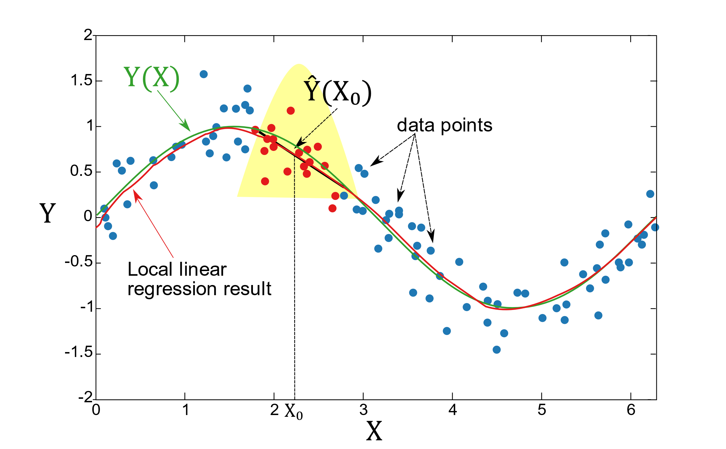
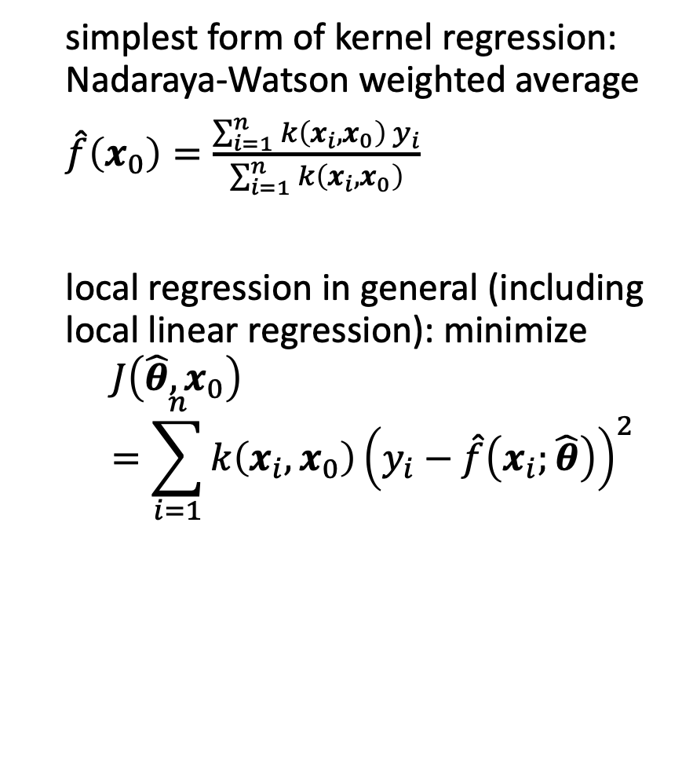
Kernel Regression
simplest form of kernel regression: Nadaraya-Watson weighted average
$\hat{f}\left(x_{0}\right)=\frac{\sum_{i=1}^{n}{k\left(x_{i},x_{0}\right) y_{i}}}{\sum_{i=1}^{n}{k\left(x_{i},x_{0}\right)}}$
local regression in general (including local linear regression): minimize
$$J\left(\hat{θ},x_{0}\right)=\sum_{i=1}^{n}{k\left(x_{i},x_{0}\right){\left(y_{i}−\hat{f}\left(x_{i};\hat{θ}\right)\right)}^{2}}$$
linear building blocks
from wikipedia

Slide 20
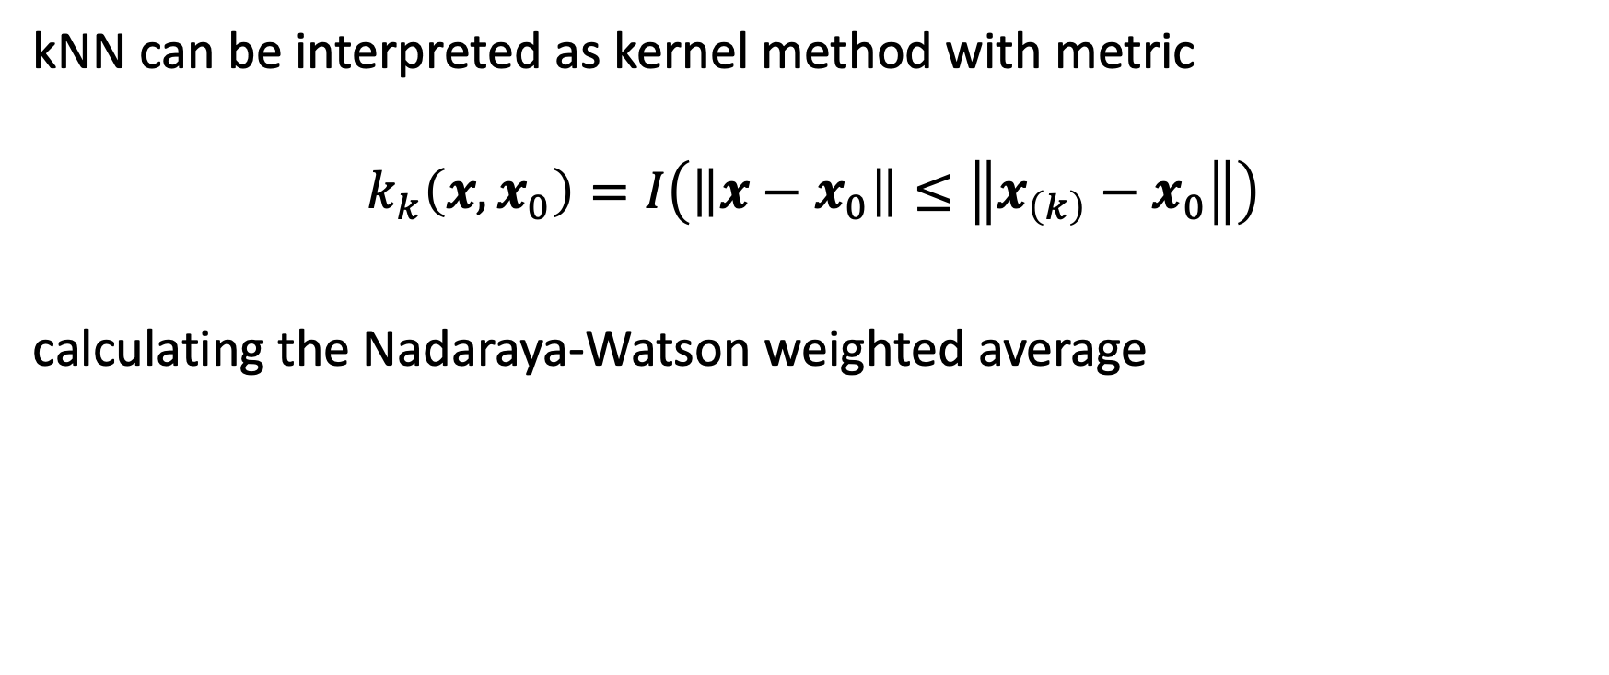
Relationship to k-Nearest Neighbors
kNN can be interpreted as kernel method with metric
$$k_{k}\left(x,x_{0}\right)=I\left(\left\|x−x_{0}\right\|≤\left\|x_{\left(k\right)}−x_{0}\right\|\right)$$
calculating the Nadaraya-Watson weighted average

Slide 21
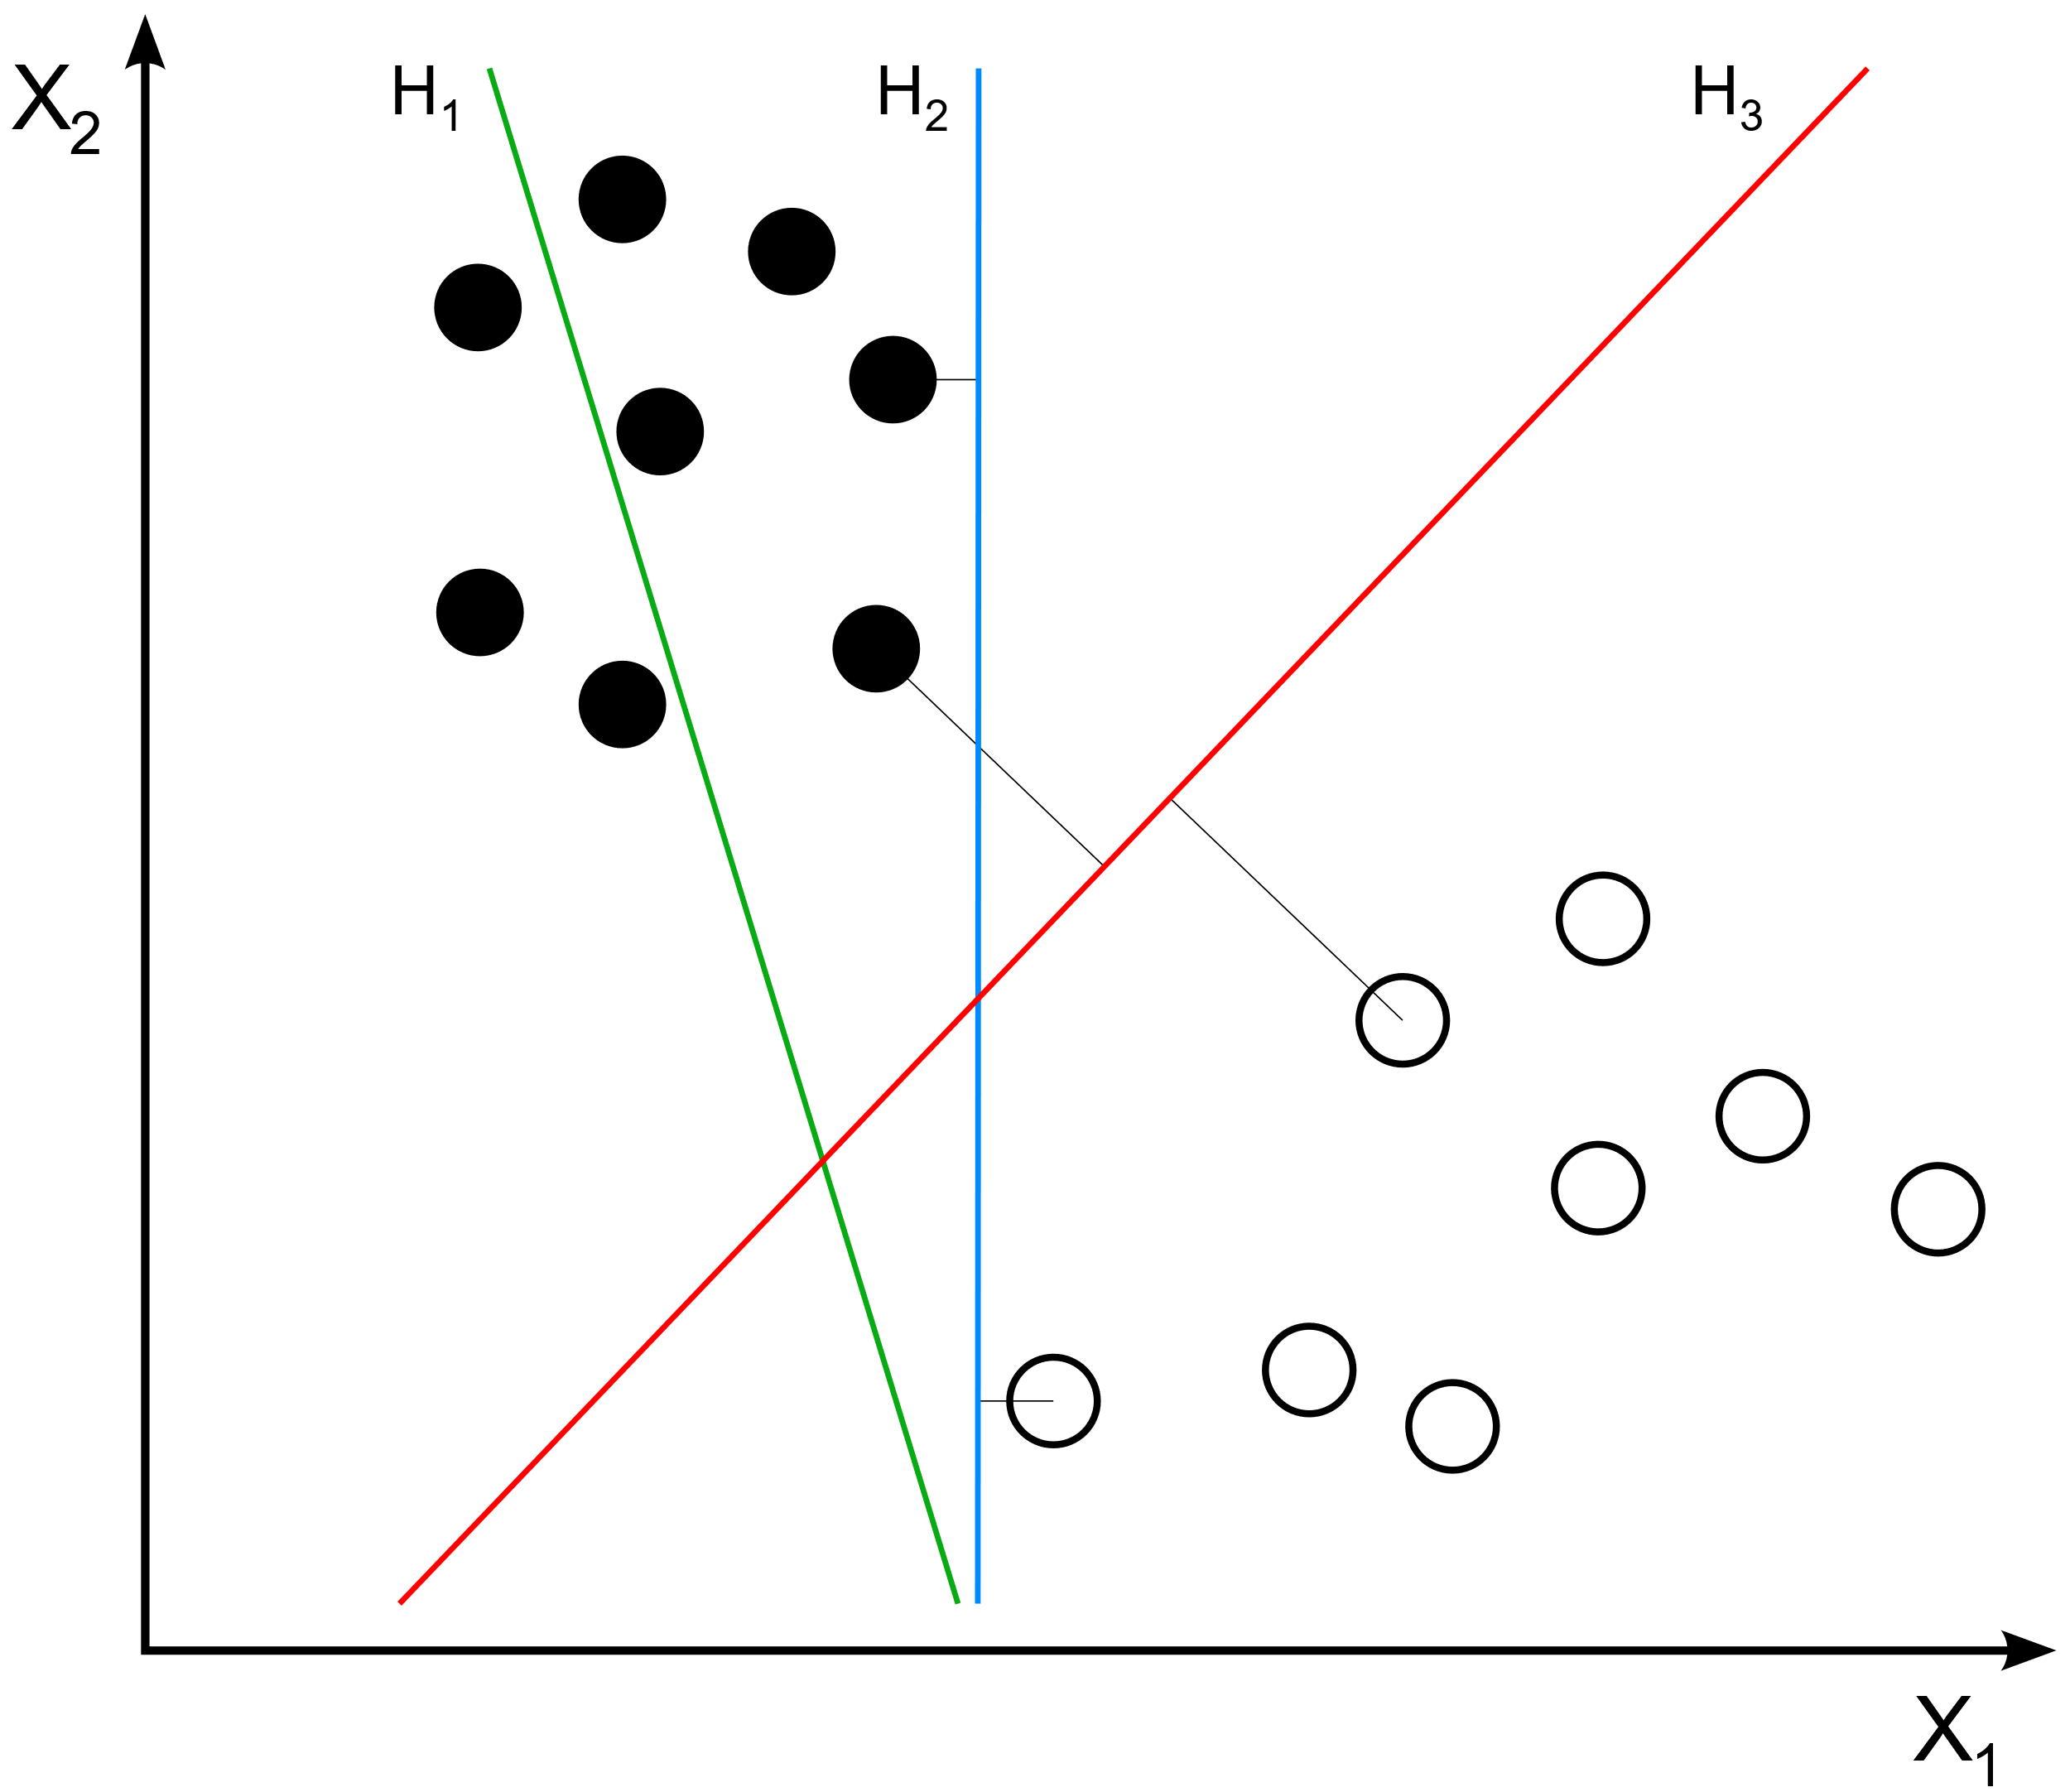
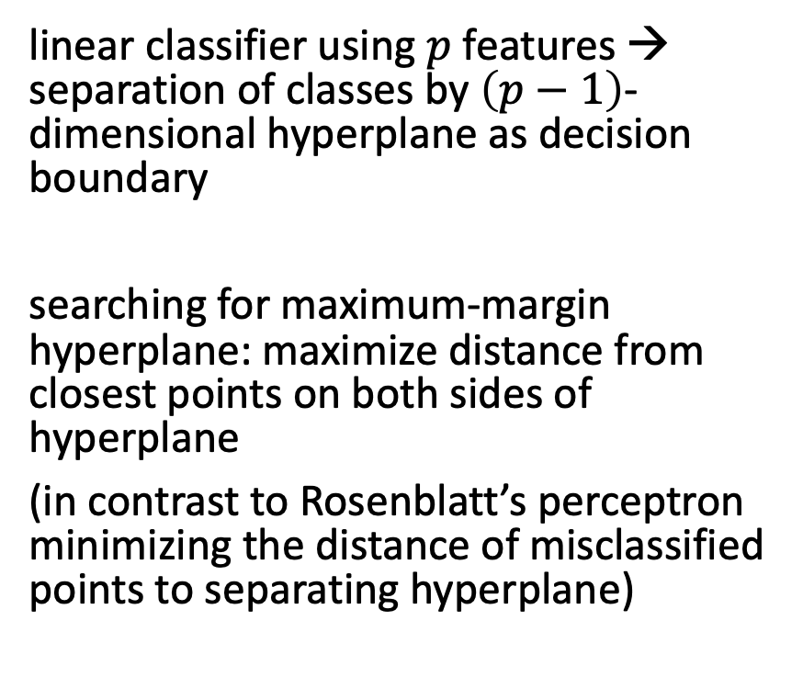
Optimal Separating Hyperplanes (toward support-vector machines)
linear classifier using $p$ features → separation of classes by $\left(p−1\right)$-dimensional hyperplane as decision boundary
searching for maximum-margin hyperplane: maximize distance from closest points on both sides of hyperplane
(in contrast to Rosenblatt’s perceptron minimizing the distance of misclassified points to separating hyperplane)
from wikipedia

Slide 22

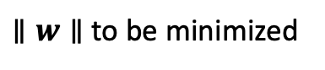
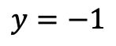
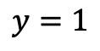
Support-Vector Machines (SVM)
classification: predict sign
$$y=1$$
maximum-margin hyperplane completely determined by (linear combination of) data points closest to it: support vectors
(identification of support vectors requires all data though)
hard margin:
holds only if classes are linearly separable (for training, not necessarily for test data)
$$y=−1$$
from wikipedia
$∥w∥$ to be minimized

Slide 23
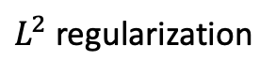
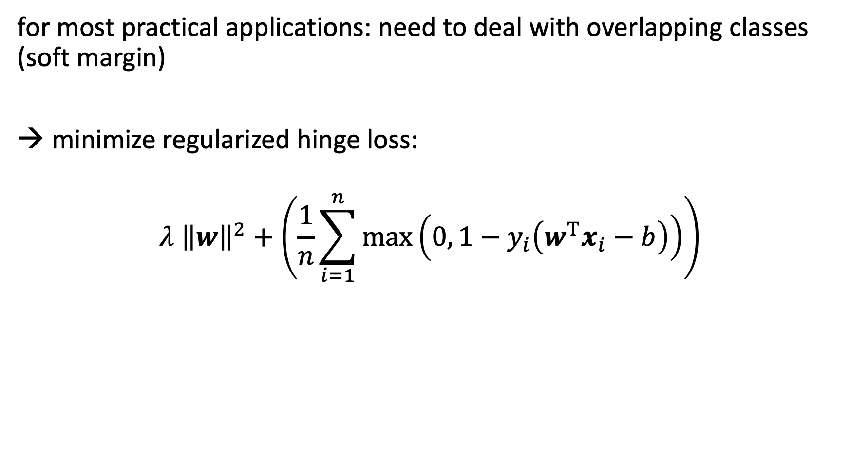
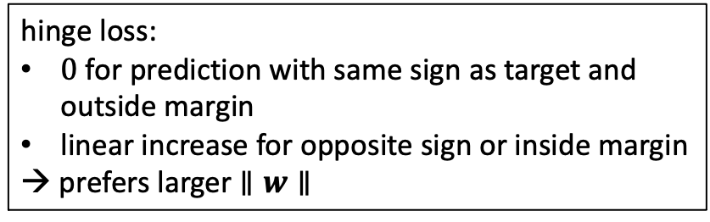
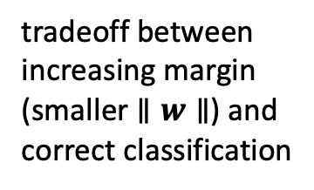
Soft-Margin SVM
for most practical applications: need to deal with overlapping classes (soft margin)
→ minimize regularized hinge loss:
$$λ {\left\|w\right\|}^{2}+\left(\frac{1}{n}\sum_{i=1}^{n}{\max\left(0, 1−y_{i}\left(w^{T}x_{i}−b\right)\right)}\right)$$
hinge loss:
$0$ for prediction with same sign as target and outside margin
linear increase for opposite sign or inside margin
→ prefers larger $∥w∥$
tradeoff between increasing margin (smaller $∥w∥$) and correct classification
$L^{2}$ regularization

Slide 24
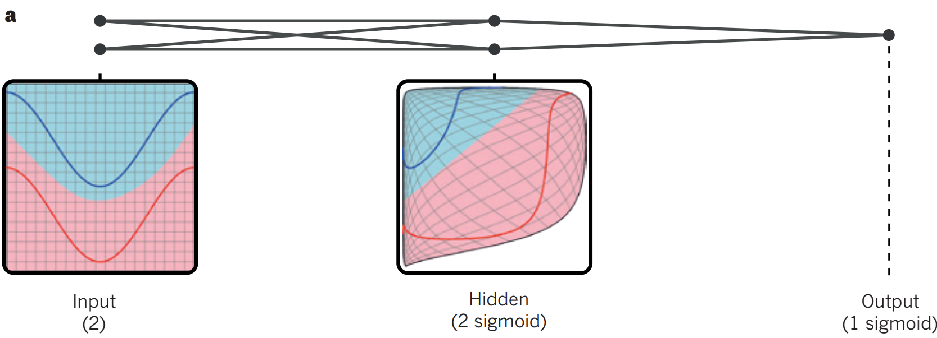
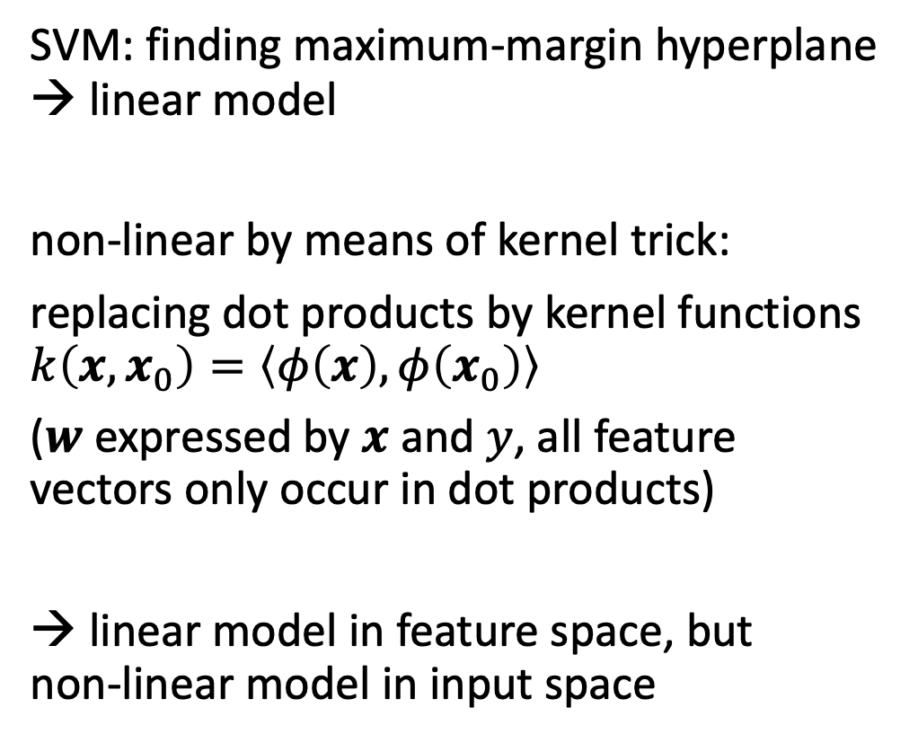
Go Non-Linear via Kernels
similar in neural network:
source
SVM: finding maximum-margin hyperplane → linear model
non-linear by means of kernel trick:
replacing dot products by kernel functions $k\left(x,x_{0}\right)=\left\langle φ\left(x\right),φ\left(x_{0}\right)\right\rangle$
($w$ expressed by $x$ and $y$, all feature vectors only occur in dot products)
→ linear model in feature space, but non-linear model in input space
from towardsdatascience.com
kernel method not restricted to SVMs
non-linear generalization to any algorithm expressable in dot products
e.g., principal component analysis

Slide 25
History: Another AI (Neural Network) Winter
… to be continued
in mid 1990s, neural networks with several layers (nowadys called deep learning) did not work well yet for practical applications (except for CNNs to some degree)
issues with vanishing/exploding gradients in backpropagation
hardware not yet fast enough, not enough data
→ advent of SVMs (and other methods like random forests) marked another small AI winter (at least for neural networks)
solidly founded in statistical learning theory
kind of equivalent to two-layer neural networks
easier to handle than difficult to work with neural networks
kernel trick (feature space transformation) reduces need for a priori knowledge

Slide 26
Decision Trees

Slide 27
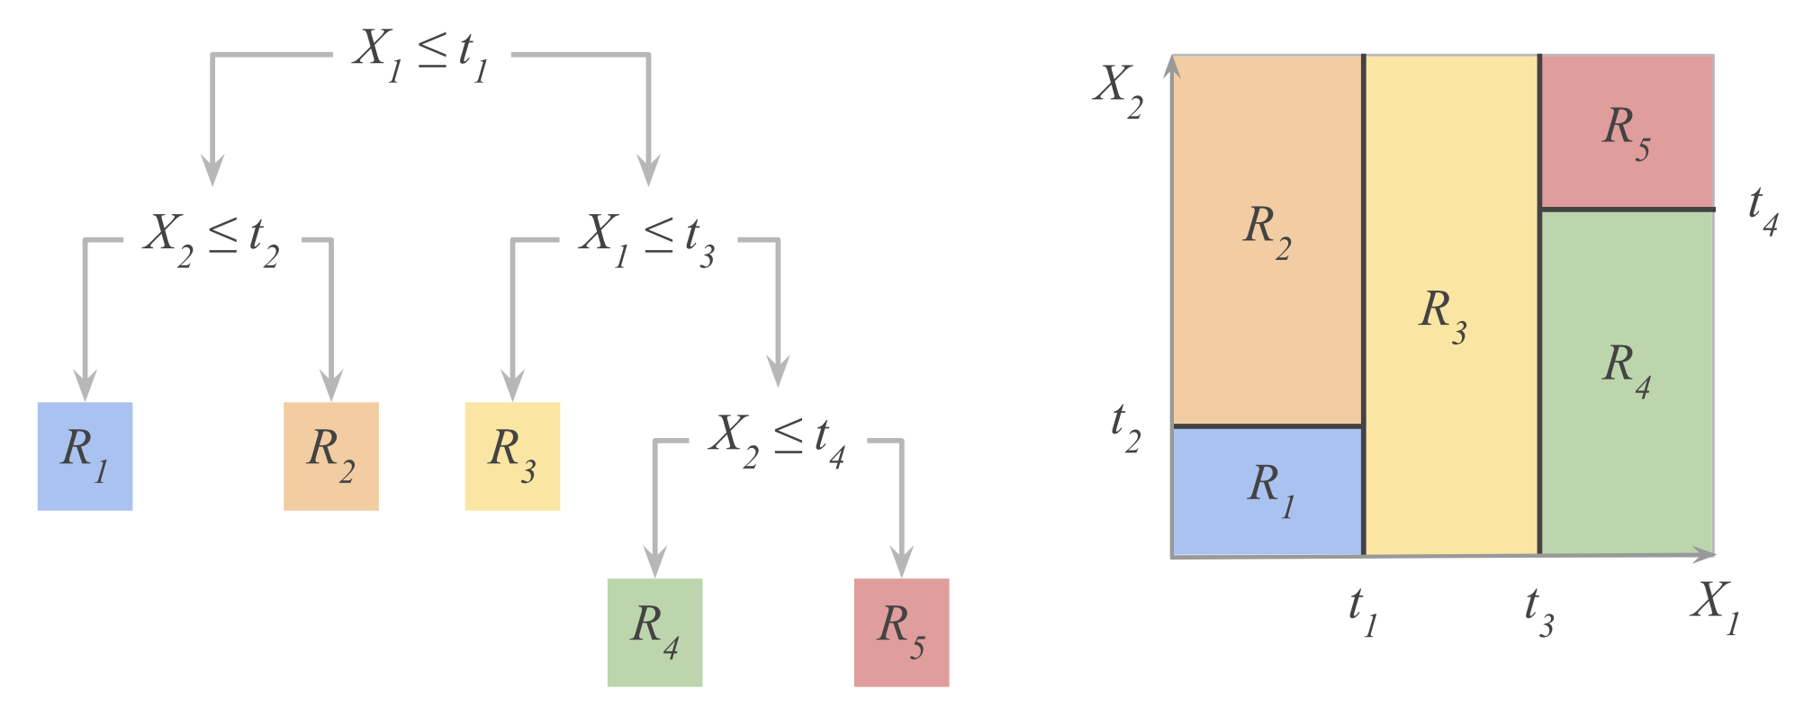
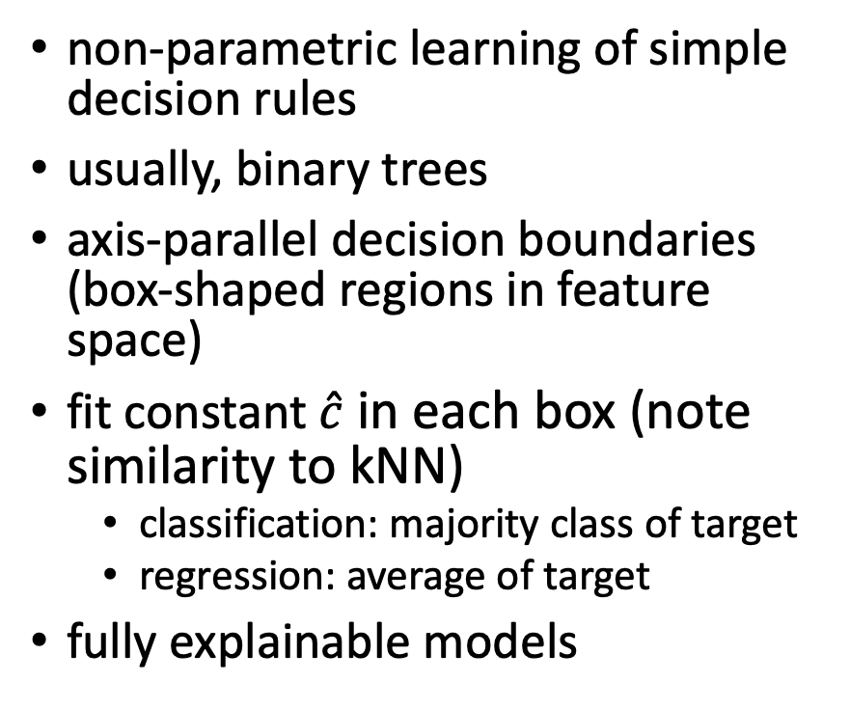
White-Box Model
non-parametric learning of simple decision rules
usually, binary trees
axis-parallel decision boundaries (box-shaped regions in feature space)
fit constant $\hat{c}$ in each box (note similarity to kNN)
classification: majority class of target
regression: average of target
fully explainable models
from Hastie

Slide 28
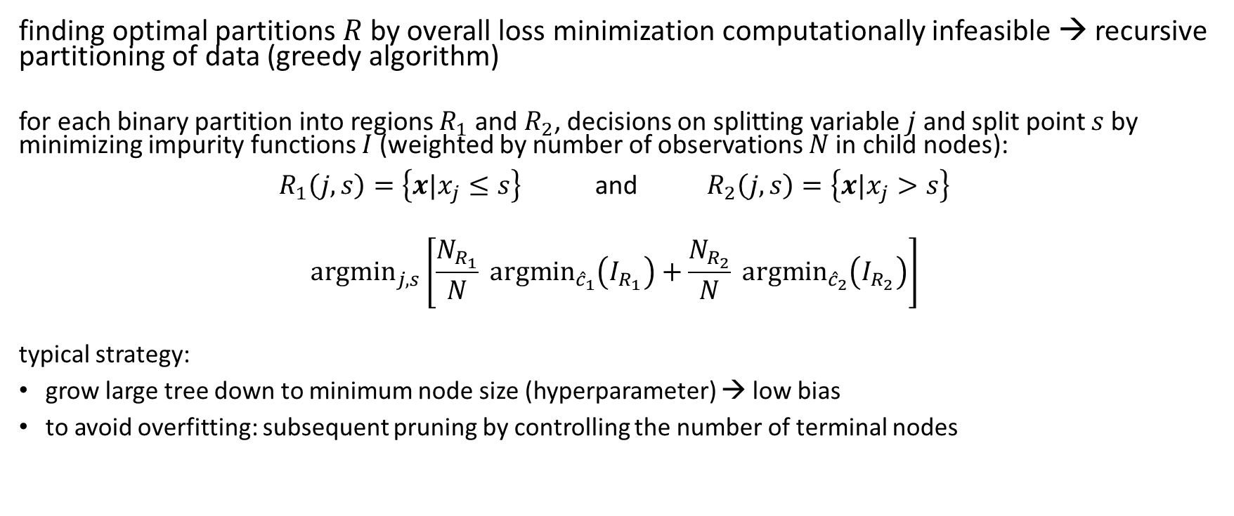
Decision Tree Learning
finding optimal partitions $R$by overall loss minimization computationally infeasible → recursive partitioning of data (greedy algorithm)
for each binary partition into regions $R_{1}$ and $R_{2}$, decisions on splitting variable $j$ and split point $s$ by minimizing impurity functions $I$ (weighted by number of observations $N$in child nodes):
$R_{1}\left(j,s\right)=\left\{x|x_{j}≤s\right\}$ and $R_{2}\left(j,s\right)=\left\{x|x_{j}>s\right\}$
$${argmin}_{j,s}\left[\frac{N_{R_{1}}}{N} {argmin}_{{\hat{c}}_{1}}\left(I_{R_{1}}\right)+\frac{N_{R_{2}}}{N} {argmin}_{{\hat{c}}_{2}}\left(I_{R_{2}}\right)\right]$$
typical strategy:
grow large tree down to minimum node size (hyperparameter) → low bias
to avoid overfitting: subsequent pruning by controlling the number of terminal nodes
recursively for each node in tree

Slide 29


Regression Trees
another possible hyperparameter
usually, mean squared error as impurity function (analogous for $R_{2}$):
$$I_{R_{1}}=\sum_{x_{i}∈R_{1}\left(j,s\right)}{{\left(y_{i}−{\hat{c}}_{1}\right)}^{2}}$$
→ ${argmin}_{{\hat{c}}_{1}}\left(I_{R_{1}}\right)$ solved by ${\hat{c}}_{1}={\overline{y}}_{R_{1}}$
for ${argmin}_{j,s}$, choose boxes to make target averages in each box as different as possible
from scikit-learn
linear (in fact, constant) building blocks

Slide 30



Impurity Functions for Classification Trees
classification in given node according to majority class
several possibilities for impurity function used for classification, preferred ones:
Gini index (used in popular CART algorithm):
$$2p\left(1−p\right)$$
difference in entropy, aka information gain (used in popular C4.5 algorithm):
$$−p \log{p}−\left(1−p\right)\log\left(1−p\right)$$
node impurity as function of class proportion $p$ (two-class classification):
from Hastie

Slide 31
Ensemble Methods

Slide 32
Ensemble Learning
idea:
combine several individual models (often of the same type) to form an ensemble model with better predictive performance than each of its constituents
learning in several different ways from the training data
the trainings of the individual constituent models are (kind of) independent
outputs of individual models are combined (e.g., averaged)

Slide 33

Bagging (Bootstrap Aggregating)
idea: train individual models of ensemble method on random (sub)sets of the training data (random sample with replacement)
reduces variance of ensemble model compared to individual models
but not bias → use low-bias base models
individual models combined by averaging (regression) or majority voting (classification) → committee of models
example with decision trees:
source

Slide 34
Random Subspace Method
aka feature bagging
idea: train different members (models) of an ensemble method on random subsets of all features (random sample with replacement)
reduce correlation between ensemble members
individual models combined by averaging (regression) or majority voting (classification) → committee of models

Slide 35
Random Forest
ensemble method using
decision trees as individual models (usually, rather large, low-bias decision trees)
combination of bagging and random subspace method (features sampled at each node in the trees)
compared to individual decision trees, random forests
reduce variance → improve accuracy
lose explainability
one of the most popular off-the-shelf ML algorithms (often, good performance with little hyperparameter tuning and data preparation)

Slide 36
Boosting
idea: sequentially learn and combine several “weak” learners (such as small decision trees, but in principle any ML algorithm) to construct a “strong” one
→ gradually (in a greedy fashion) reducing bias of ensemble model
in simple terms:
building a model from the training data, then creating a second model that attempts to correct the errors from the first model, …
→ each subsequent weak learner is forced to concentrate on the examples that are missed by the previous ones in the sequence
not a committee of models
typically, use simple, high-bias methods as individual models

Slide 37

Forward Stagewise Additive Modeling
boosting can be understood as fitting an additive expansion in a set of basis functions $b\left(x;{\hat{γ}}_{m}\right)$ (e.g., decision trees, with ${\hat{γ}}_{m}$ parametrizing splits): $\hat{f}\left(x\right)=\sum_{m=1}^{M}{{\hat{β}}_{m} b\left(x;{\hat{γ}}_{m}\right)}$
loss minimization of $\hat{f}\left(x\right)$ computationally expensive → boosting: sequentially add and fit individual basis functions without changing already fitted ones
boosting algorithm for sequential optimization using basis functions:
initialize ${\hat{f}}_{0}\left(x\right)=0$
for $m=1$ to $M$
compute $\underset{{\hat{β}}_{m},{\hat{γ}}_{m}}{argmin}{\sum_{i=1}^{N}{L\left(y_{i},{\hat{f}}_{m−1}\left(x_{i}\right)+{\hat{β}}_{m} b\left(x_{i};{\hat{γ}}_{m}\right)\right)}}$
set ${\hat{f}}_{m}\left(x\right)={\hat{f}}_{m−1}\left(x\right)+{\hat{β}}_{m} b\left(x;{\hat{γ}}_{m}\right)$

Slide 38






AdaBoost (Adaptive Boosting)
in its simplest form: binary classification
forward stagewise additive modeling with individual classifiers ${\hat{G}}_{m}$ and loss function $L\left(y,\hat{f}\left(x\right)\right)=e^{−y \hat{f}\left(x\right)}$
$$\left({\hat{β}}_{m},{\hat{G}}_{m}\right)=\underset{\hat{β}, \hat{G}}{argmin}{\sum_{i=1}^{N}{e^{−y_{i} {\hat{f}}_{m−1}\left(x_{i}\right)}e^{−\hat{β} y_{i} \hat{G}\left(x_{i}\right)}}}$$
corresponds to sample weights $w_{i}$ (in the trainings for ${\hat{G}}_{m}$), reflecting accuracy of current ensemble at each successive iteration (weights increased for incorrect predictions, decreased for correct ones)
$${\hat{α}}_{m}=2 {\hat{β}}_{m}$$
$$w_{i}\left(\left(x_{i}, y_{i}\right)\right)$$
two steps:
(1): weighted error rate minimized by ${\hat{G}}_{m}$:
$${err}_{m}=\frac{\sum_{i=1}^{N}{w_{i}^{(m)} I\left(y_{i}≠{\hat{G}}_{m}\left(x_{i}\right)\right)}}{\sum_{i=1}^{N}{w_{i}^{(m)}}}$$
→ (2): ${\hat{β}}_{m}=\frac{1}{2}\log{\frac{1−{err}_{m}}{{err}_{m}}}$
from Hastie

Slide 39


Gradient Boosting
approximation of forward stagewise additive modeling (solution can be hard for general $L$):
${\hat{f}}_{m}\left(x\right)={\hat{f}}_{m−1}\left(x\right)+{\hat{h}}_{m}\left(x\right)$ by successively solving $\underset{{\hat{h}}_{m} }{argmin}{\sum_{i=1}^{N}{L\left(y_{i},{\hat{f}}_{m}\left(x_{i}\right)\right)}}$
$$\tilde{L}\left(y_{i},{\hat{f}}_{m}\left(x_{i}\right)\right)≈L\left(y_{i},{\hat{f}}_{m−1}\left(x_{i}\right)\right)+{\hat{h}}_{m}\left(x_{i}\right) {\left[\frac{∂L\left(y_{i}, \hat{f}\left(x_{i}\right)\right)}{∂\hat{f}\left(x_{i}\right)}\right]}_{\hat{f}={\hat{f}}_{m−1}}$$
→ ${\hat{h}}_{m}\left(x\right)≈\underset{{\hat{h}}_{m} }{argmin}{\sum_{i=1}^{N}{{\hat{h}}_{m}\left(x_{i}\right) g_{im}}}$
${\hat{h}}_{m}$ fitted to predict negative gradients of samples at each iteration (regression model), corresponding to gradient descent in functional space
${\hat{h}}_{m}$: usually, decision tree regressors of fixed size (gradient-boosted decision trees)
works like this for both regression and classification (just different loss functions)
$$g_{im}$$

Slide 40

Decision Tree Sizes for Boosting
consider degree to which features interact with each other in given data set (see ANOVA expansion)
decision trees with single split (aka decision stumps): covering no interaction effects, just main effects of individual features
decision trees with two splits: covering second-order interactions
decision trees with three splits: covering third-order interactions
(usually, interaction order not much higher than $\sim$5 in real-world data sets)
why boosting often works better than single large, low-bias model: uncorrelated learners, each focusing on a specific aspect of the data

Slide 41
Literature
papers:
back-propagation: one of the founding moments of deep learning
Gradient Boosting
XGBoost: uses second-order Taylor approximation in loss function (Newton-Raphson instead of gradient descent)
LightGBM: uses improved histogram-based algorithm (gains in computational speed and memory consumption)
CatBoost: uses kind of leave-one-out encoding for categorical features

Slide 42

Support Scientific Progress
AI/ML as tool to supercharge the scientific method
prime example medicine:
drug discovery, medical imaging, gene classification, protein structure prediction (AlphaFold [1, 2])
but also many other areas, e.g., material sciences (M3GNet, GNoME)
Towards Generalist Biomedical AI

